Slide 1
IN Operator
The IN operator allows you to specify multiple values in a WHERE clause.
The IN operator is a shorthand for multiple OR conditions
SELECT CNIC, Name , GPA
FROM Student
WHERE Name IN( 'Maria' , 'Maida','Madiha');
Student
CNIC | Name | Address | GPA | Did

Slide 2
IN Operator – Same Queries.
SELECT CNIC, Name , GPA
FROM Student
WHERE Name IN( 'Maria' , 'Maida','Madiha’);
SELECT CNIC, Name , GPA
FROM Student
WHERE Name = 'Maria’ or Name = 'Maida’ or Name = 'Madiha';
Student
CNIC | Name | Address | GPA | Did

Slide 3
Set Operation

Slide 4
Set Operation
Union [UNION]
Union All [UNION ALL]
Intersection [IN]
Difference [NOT IN]
A(1, 2, 3, 6) B (1, 3, 4, 5)
A U B(1,2,3,4,5,6)
A ⋂ B = (1, 3)
A – B = ( 2, 6) B – A = (4, 5)
AUB = B U A
A ⋂B = B ⋂ A
A – B != B – A

Slide 5
Union
Sql gives us a keyword of union to achieve the desired results.

Slide 6
Set Operation
Name All people (Student + Teacher) From Lahore
Name all Students who are also teaching.
Name all students who are not teaching.
Student
CNIC | Name | Address | GPA | Did
Teacher
CNIC | Name | Address | Salary | Did
Department
ID | Name | Location

Slide 7
Set Operation
Name All people (Student + Teacher) From Lahore
SELECT CNIC, Name
FROM Student
where Address LIKE '%Lahore%' UNION SELECT CNIC , Name
FROM Teacher
where Address LIKE '%Lahore%’;
Name all Students who are also teaching.
SELECT Name
FROM Student
WHERE CNIC IN (SELECT CNIC
FROM Teacher);
Name all students who are not teaching.
SELECT Name
FROM Student
WHERE CNIC NOT IN (SELECT CNIC
FROM Teacher);
Student
CNIC | Name | Address | GPA | Did
Teacher
CNIC | Name | Address | Salary | Did
Department
ID | Name | Location

Slide 8
Union Compatibility
Two tables must have equal number of attributes.
Each attribute must have same domain.
Name All people (Student + Teacher) From Lahore
SELECT CNIC, Name
FROM Student
where Address LIKE '%Lahore%' UNION SELECT CNIC , Name
FROM Teacher
where Address LIKE '%Lahore%’;

Slide 9
Use of ‘Union’ or ‘OR’
Name the student from Department 3 or GPA >3.
Name Student or Teachers from Lahore.
Student
CNIC | Name | Address | GPA | Did
Teacher
CNIC | Name | Address | Salary | Did
Department
ID | Name | Location

Slide 10
Use of ‘Union’ or ‘OR’
Name the student from Department 3 or GPA >3.
Select Name
from Student
Where did = 3 OR GPA >3;
Name Student or Teachers from Lahore.
SELECT Name
FROM Student
where Address LIKE '%Lahore%' UNION SELECT Name
FROM Teacher
where Address LIKE '%Lahore%';
Student
CNIC | Name | Address | GPA | Did
Teacher
CNIC | Name | Address | Salary | Did
Department
ID | Name | Location

Slide 11
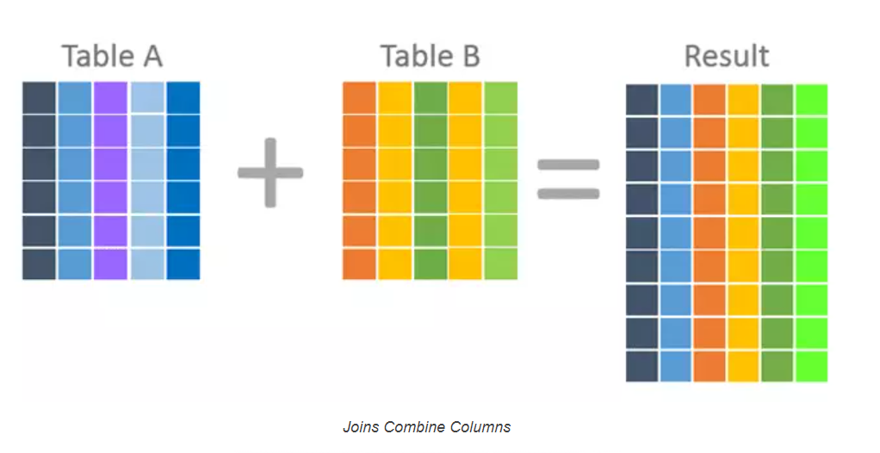
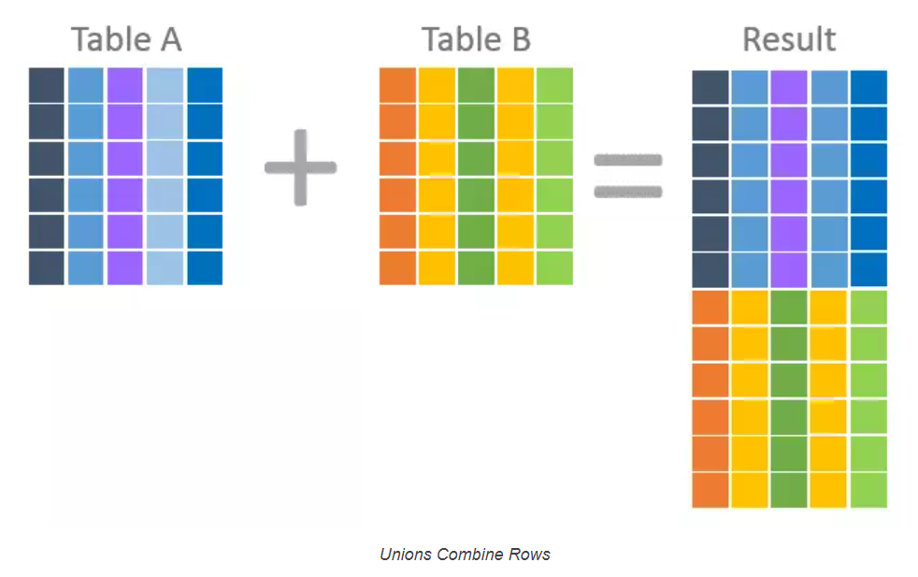
Set operation or join
https://www.essentialsql.com/what-is-the-difference-between-a-join-and-a-union/

Slide 12
Summary
You can use Join or Sub query (IN Keyword) interchangeably. Both 0have same results. And both depicts the Set operation INTERSECTION.
Union can be achieved with UNION keyword only.
To have the functionality of minus or Except we need to use NOT IN.

Slide 13
Practice Questions
Show department names in which some workers works with salary> 30,000 or it is located in Stafford.
Show employee ssn’s who are managers but don’t have any dependents.
Show manager name who have no dependents.
Make a list of all project numbers for projects that involve an employee whose last name is smith either as a worker or as a manager of dept who controls the project.
List names of employees who do not work on any project.
Fine the names of all employees who work on atleast one project located in Houston but whose department has not located in Houston.
Ans1-// located in Stafford
Select Dname
From department as d inner join project as p on

Slide 14
Show employee names who are managers and they have at least one dependent. nesting
Select fname
From employee
Where ssn in (select mgrssn from department)
And
ssn in (select essn from dependent) ;

Slide 15
Show employee names who are managers and they have at least one dependent. nesting
Select fname
From employee
Where ssn in (select mgrssn
From department
Where mgrssn in ( select essn from dependent));

Slide 16
Show employee names who are managers and they have at least one dependent. nesting
Select fname
From employee join department on mgrssn =ssn
Where ssn in ( select essn from dependent);

Slide 17
Show employee name who are managers but they do not have dependents
Select fname
From employee
Where ssn in (select mgrssn from department)
And
ssn Not in (select essn from dependent) ;

Slide 18
> All
name of all employees with salary greater than all employees of dno = 5.
SELECT Fname , Lname
FROM Employee
WHERE salary > ALL (SELECT salary
FROM EMPLOYEE
WHERE Dno = 5);

Slide 19
> Any
name of all employees with salary greater than any employee of dno = 5.
SELECT Fname , Lname
FROM Employee
WHERE salary > Any (SELECT salary
FROM EMPLOYEE
WHERE Dno = 5);

